Slide 1

Language Engineering with
The GEMOC Studio
Tutorial @ MODELS 2017, September 18th, 2017
Benoit Combemale (Univ. Toulouse)
http://www.combemale.fr
benoit.combemale@irit.fr
@bcombemale
Julien Deantoni (Univ. Nice-Sophia-Antipolis)
http://www.i3s.unice.fr/~deantoni/
julien.deantoni@polytech.unice.fr
Notes:
<number>

Slide 2
Tutorial website
https://github.com/gemoc/MODELS2017Tutorial
See:
README
/slides/tutorial-slides.pptx
/code/* ☺
GEMOC Studio Tutorial @ MODELS 2017 – Benoit Combemale and Julien Deantoni – Sep., 2017
- <number>

Slide 3
LANGUAGE ENGINEERING
- <number>

Slide 4
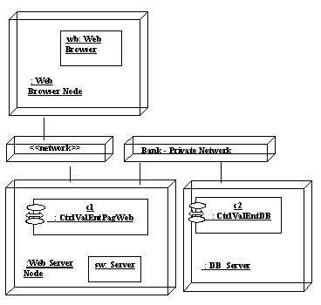
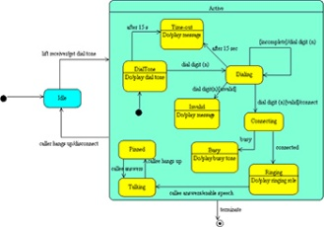
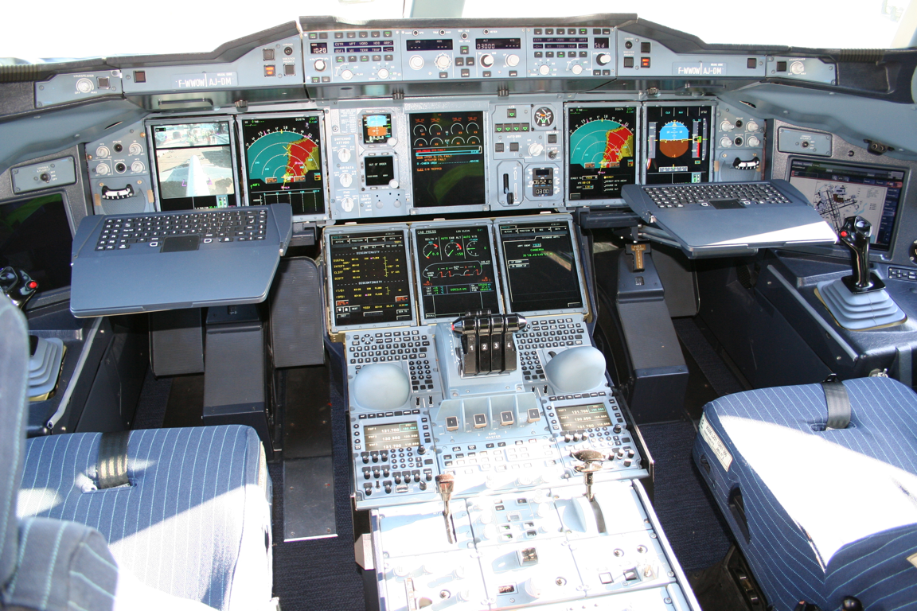
Model-Driven Engineering (MDE)
Security
Distribution
Fault tolerance
Functional behavior
Use case
borrow
Platform
Model
deliver
return
Design Model
reserve
setDamaged
Book
User
state : String
Code Model
"Perhaps surprisingly, the majority of MDE examples in our study followed domain-specific modeling paradigms"
J. Whittle, J. Hutchinson, and M. Rouncefield, “The State of Practice in Model-Driven Engineering,” IEEE Software, vol. 31, no. 3, 2014, pp. 79–85.
GEMOC Studio Tutorial @ MODELS 2017 – Benoit Combemale and Julien Deantoni – Sep., 2017
- <number>
Notes:
Oldie but goodie
<number>

Slide 5

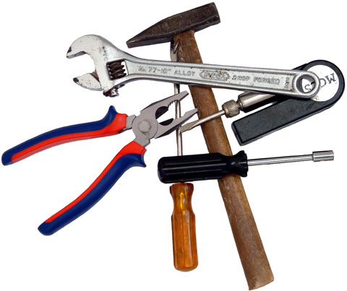
Domain-Specific Languages (DSLs)
Tailored for a particular kind of problem, with dedicated notations (textual or graphical), support (editor, checkers, etc.)
Promises: more « efficient » languages for resolving a set of specific problems in a domain
DSL ~ Modeling Language!
GEMOC Studio Tutorial @ MODELS 2017 – Benoit Combemale and Julien Deantoni – Sep., 2017
- <number>

Slide 6
"Software languages are software too"
J-M. Favre, D. Gasevic, R. Lämmel, and E. Pek. "Empirical language analysis in software linguistics," In Software Language Engineering, volume 6563 of LNCS, pages 316–326. Springer, 2011.
GEMOC Studio Tutorial @ MODELS 2017 – Benoit Combemale and Julien Deantoni – Sep., 2017
- <number>

Slide 7
Software Language Engineering (SLE)
Application of systematic, disciplined, and measurable approaches to the development, deployment, use, and maintenance of software languages
Various shapes and ways to implement software languages
External, internal or embedded DSLs, Profile, etc.
Grammar, metamodel, ontology, etc.
Supported by various kind of "language workbench"
Eclipse EMF, Xtext, Sirius, Melange, GEMOC, Papyrus
Jetbrain’s MPS
Spoofax
MS DSL Tools
Etc.
More and more literature, a dedicated Intl. conference (ACM SLE, cf. http://www.sleconf.org)…
GEMOC Studio Tutorial @ MODELS 2017 – Benoit Combemale and Julien Deantoni – Sep., 2017
- <number>

Slide 8
GEMOC
- <number>

Slide 9

The GEMOC initiative
An open and international initiative to
foster globalization of DSMLs in open world
impossible a priori unification
requires a posteriori globalization
coordinate (between members) and disseminate (for the members)
Organizes
workshop series
Seminars at Dagstuhl, Bellairs
http://gemoc.org @gemocinitiative
- <number>

Slide 10
The GEMOC Research Challenges
Modular language design and implementation
Language interfaces
Composition operators (for reuse/variability management, for coordination, …)
- <number>

Slide 11

The GEMOC Eclipse Research Consortium
Sustain the GEMOC initiative as a research platform
Project commitment
Own budget for maintaining the studio and the dissemination
- <number>

Slide 12



The GEMOC Studio
http://gemoc.org/studio
Language
Workbench
Modeling
Workbench
Design and compose your executable DSMLs
Edit and debug
your heterogeneous models
- <number>
Notes:
<number>

Slide 13

The GEMOC Eclipse Project
http://eclipse.org/gemoc
Sustain the GEMOC studio as a research platform
To support experimentations of new solutions by academics
To support pilot projects by industry
To foster relationships between academia and industry
To help industrial transfer and innovation
- <number>
Notes:
<number>

Slide 14
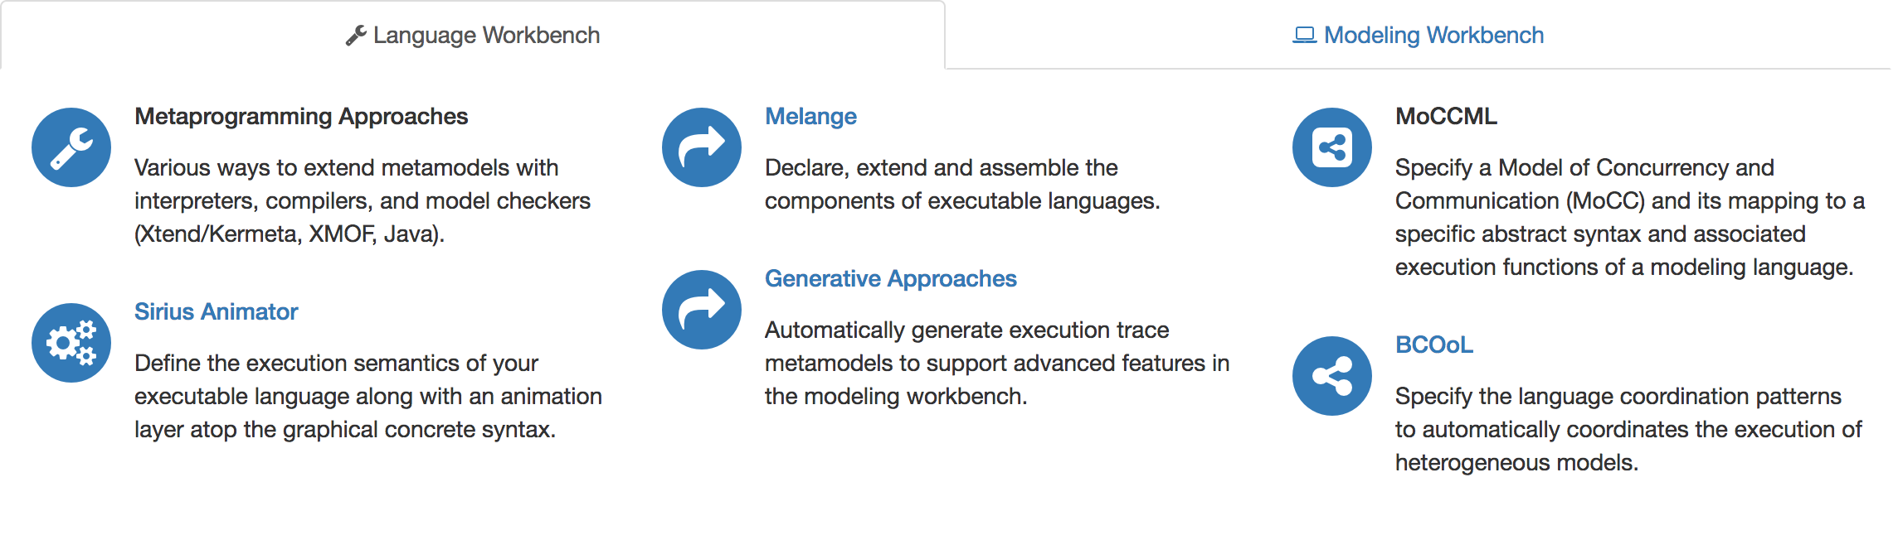
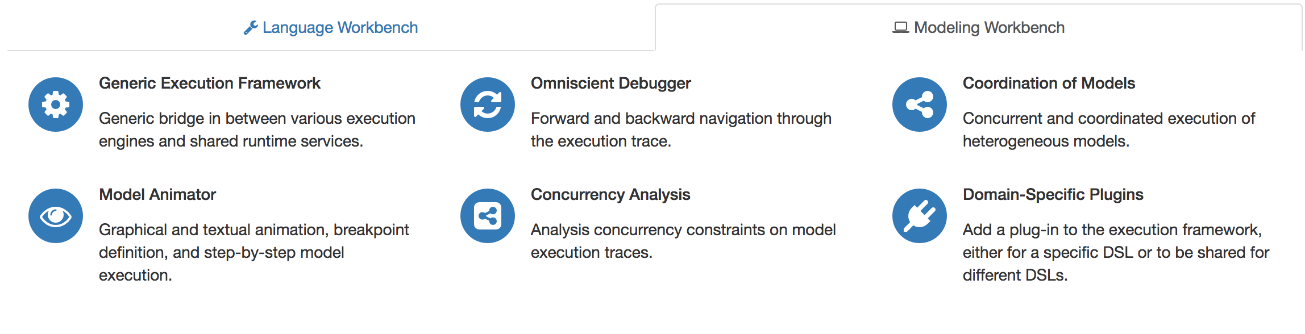

The GEMOC Studio: Major Components
- <number>

Slide 15
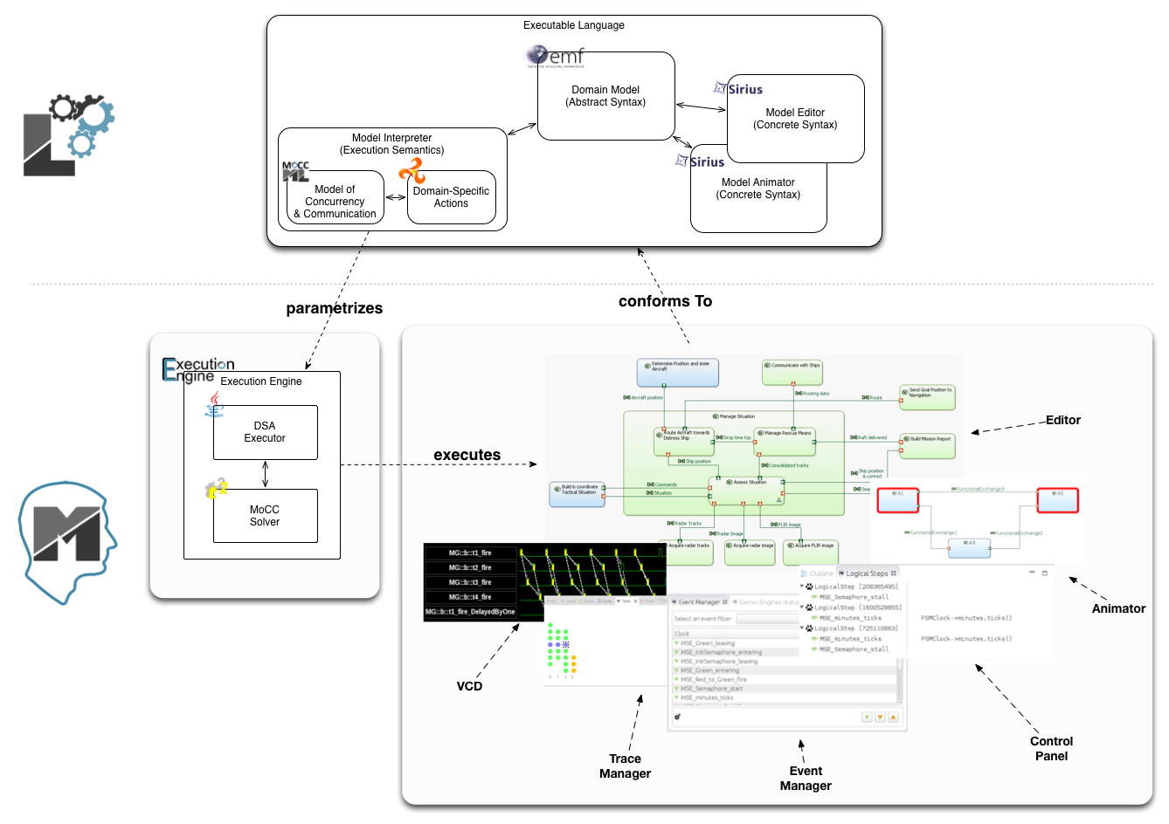
The GEMOC Studio
Benoit Combemale, Julien Deantoni, Olivier Barais, Arnaud Blouin, Erwan Bousse, Cédric Brun, Thomas Degueule and Didier Vojtisek, "A Solution to the TTC'15 Model Execution Case Using the GEMOC Studio," In 8th Transformation Tool Contest (TTC), 2015. Overall Winner
http://gemoc.org/studio/
- <number>

Slide 16
Breathe Life Into Your Designer!
- <number>
Notes:
<number>

Slide 17
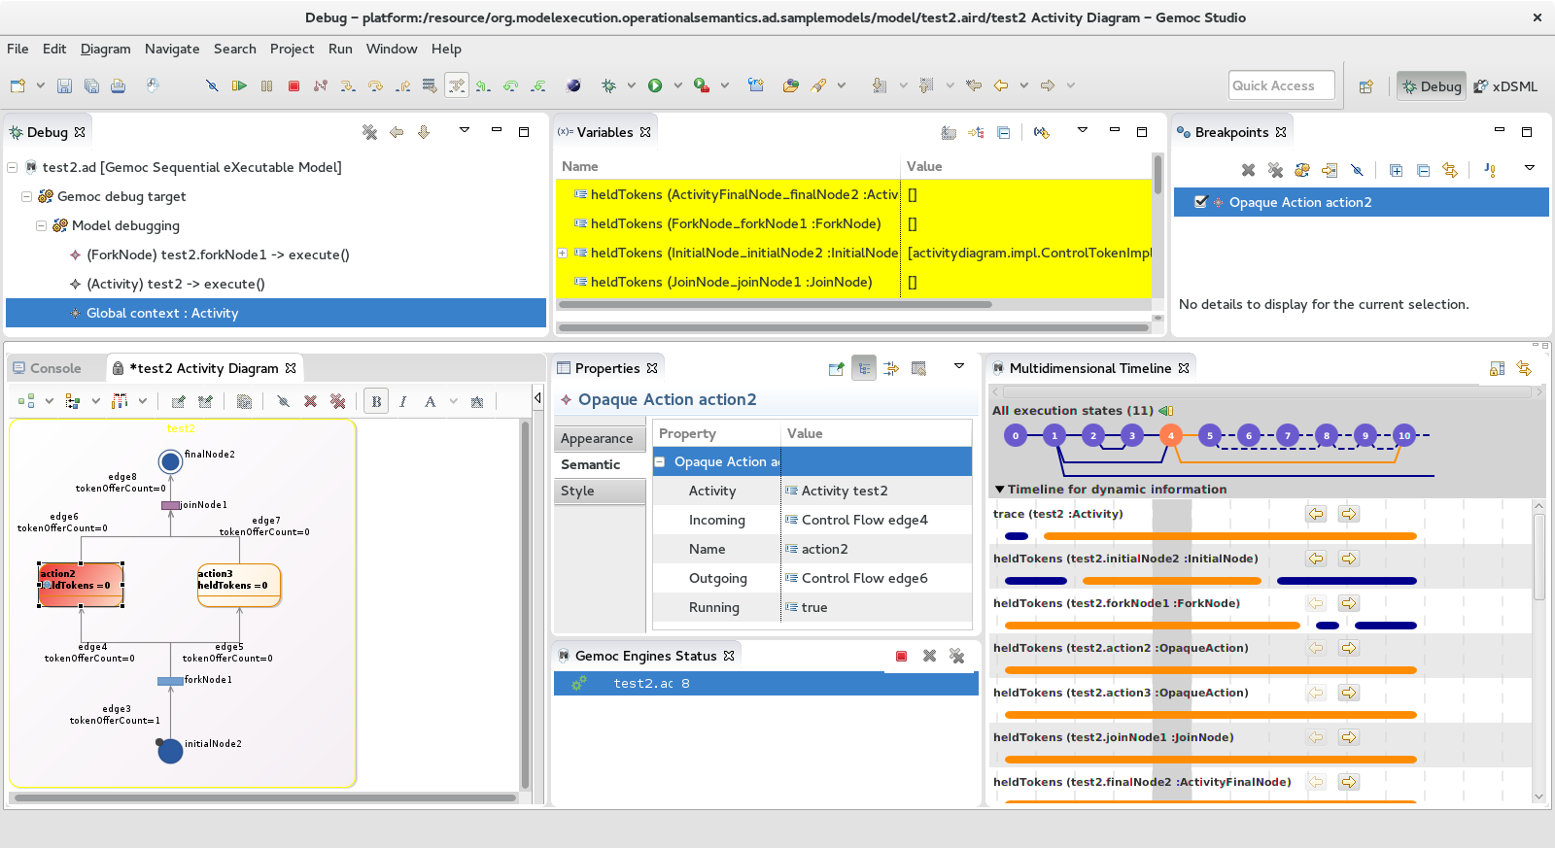
Activity Diagram Debugger
https://github.com/gemoc/activitydiagram
- <number>

Slide 18
Reifying Concurrency in xDSML: Limitations
Concurrency remains implicit and ad-hoc in language design and implementation:
Design: implicitly inherited from the meta-language used
Implementation: mostly embedded in the underlying execution environment
The lack of an explicit concurrency specification in language design prevents:
leveraging the concurrency concern of a particular domain or platform
a complete understanding of the behavioral semantics
effective concurrency-aware analysis techniques
effective techniques for producing semantic variants
analysis of the deployment on parallel architectures
- <number>

Slide 19
Reifying Concurrency in xDSML: Approach
- <number>

Slide 20
Weave Concurrency Constraints Into Your DSL!
Benoit Combemale, Julien Deantoni, Matias Vara Larsen, Frédéric Mallet, Olivier Barais, Benoit Baudry, Robert France, "Reifying Concurrency for Executable Metamodeling," In Software Language Engineering (SLE), 2013
- <number>
Notes:
<number>

Slide 21
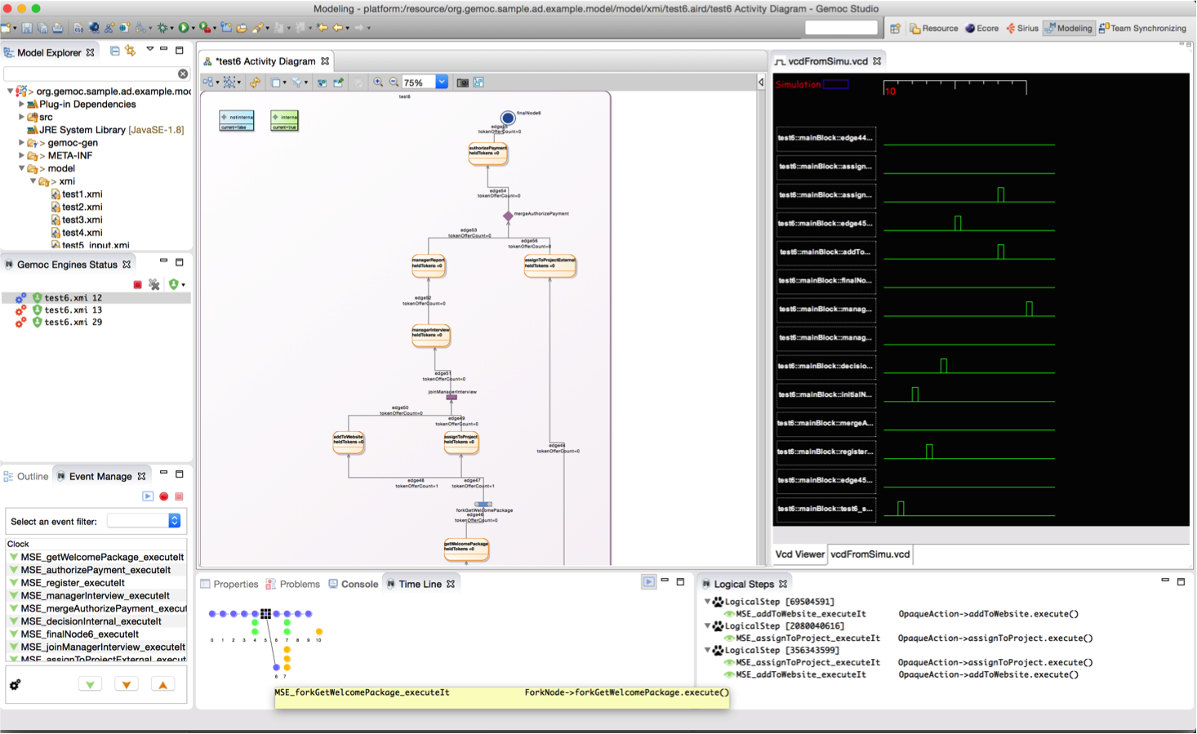
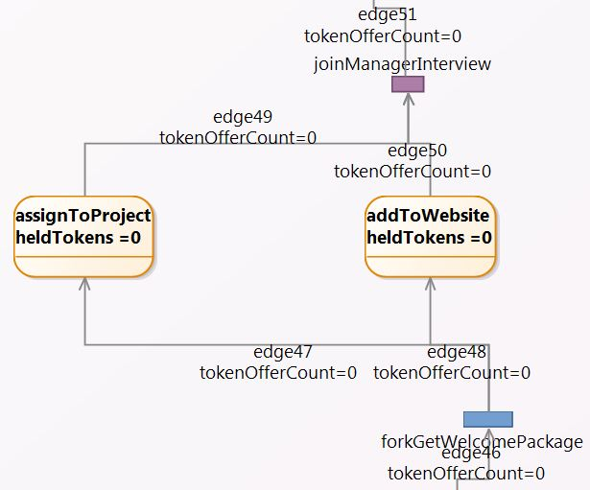
Activity Diagram Debugger
Benoit Combemale, Julien Deantoni, Matias Vara Larsen, Frédéric Mallet, Olivier Barais, Benoit Baudry, Robert France, "Reifying Concurrency for Executable Metamodeling," In Software Language Engineering (SLE), 2013
- <number>

Slide 22
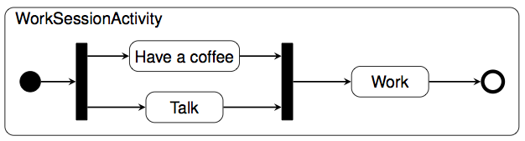
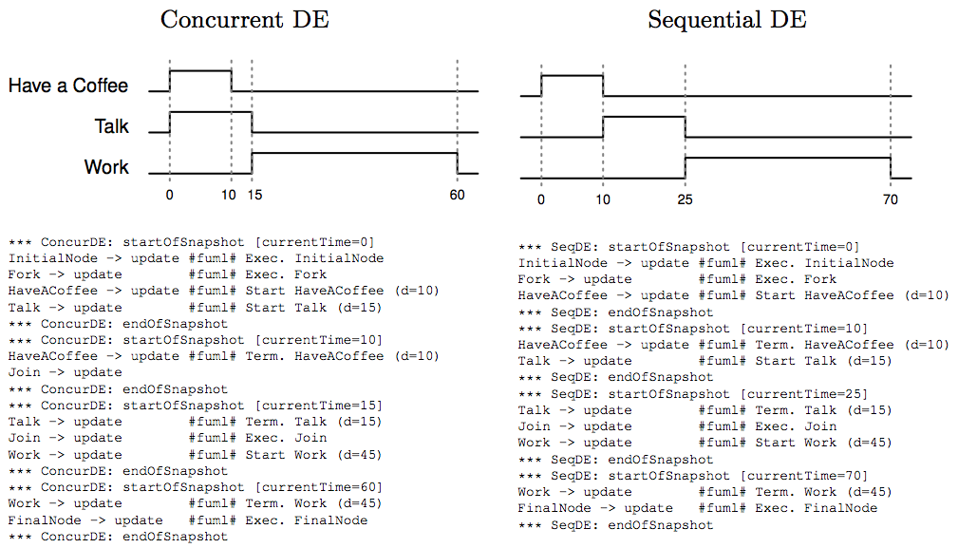
Coping with Semantic Variation Points
Florent Latombe, Xavier Crégut, Julien Deantoni, Marc Pantel, Benoit Combemale, "Coping with Semantic Variation Points in Domain-Specific Modeling Languages", In EXE@MoDELS 2015.
- <number>

Slide 23
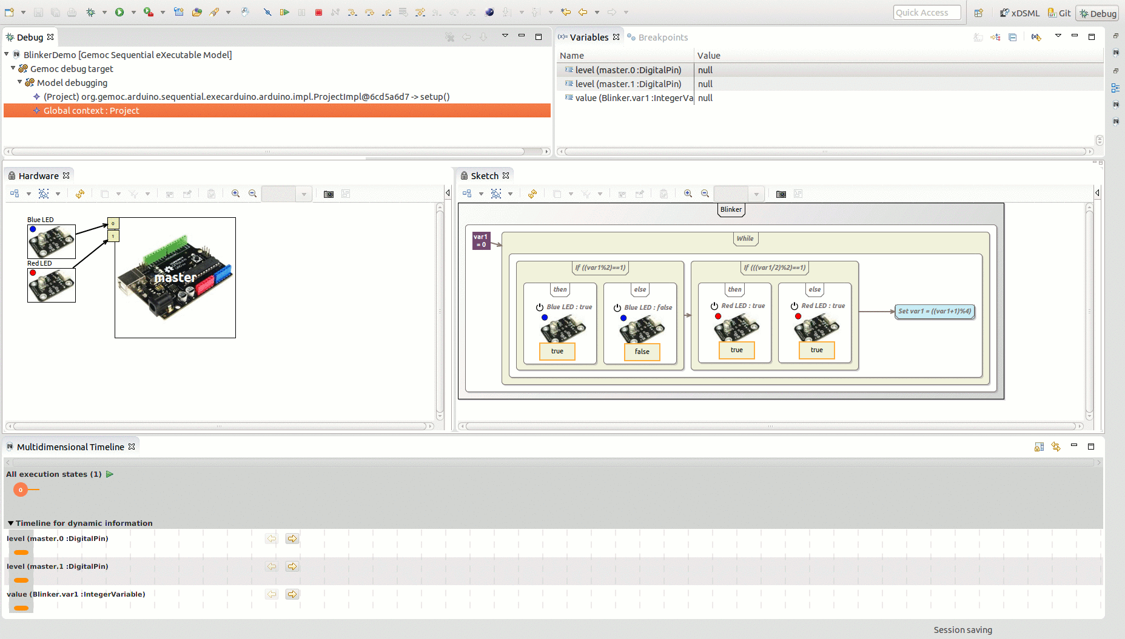
Arduino Designer (& Debugger)
https://github.com/gemoc/arduinomodeling
- <number>

Slide 24
Transformation Lg Debugger
TETRABox
http://modeltransformation.net/tetrabox/
Wimmer, Bousse et al.
https://github.com/tetrabox/minitl
- <number>

Slide 25
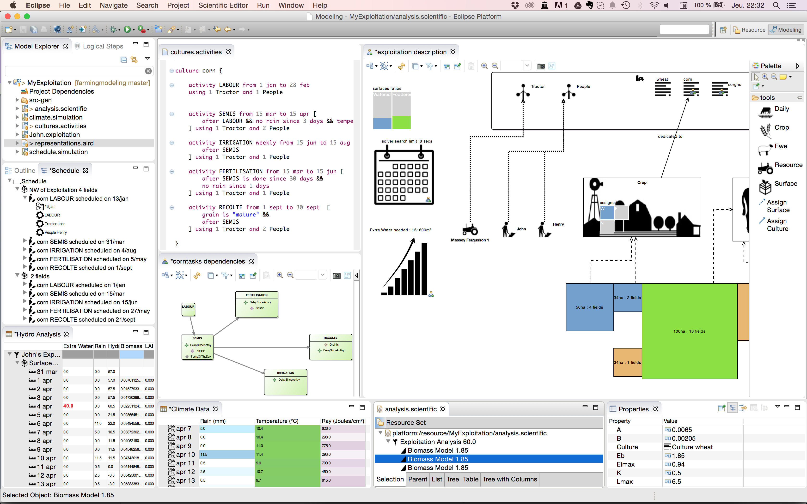
Farming System Modeling
https://github.com/gemoc/farmingmodeling
- <number>

Slide 26

Behavioral Model Coordination
Matias Ezequiel Vara Larsen, Julien Deantoni, Benoit Combemale, Frédéric Mallet, "A Behavioral Coordination Operator Language (BCOoL)," In MODELS 2015
- <number>

Slide 27
The GEMOC Studio
EMF, Xtext, Sirius
Metaprogramming Approaches (Xtend/K3, ALE, XMOF, Java)
Sirius Animator (graphical animation)
Melange (language reuse)
Generative Approaches (execution trace, checking)
MoCCML (concurrency analysis)
BCOoL (behavioral coordination)
Generic Execution Framework
Graphical animation
Breakpoint definition on model element
Multi-dimensional and efficient trace management
Model omniscient debugging facilities (incl., timeline, step backward, stimuli management, etc.)
Concurrency Analysis
Coordination of Models
Domain-Specific Plugins
Benoit Combemale, Julien Deantoni, Olivier Barais, Arnaud Blouin, Erwan Bousse, Cédric Brun, Thomas Degueule and Didier Vojtisek, "A Solution to the TTC'15 Model Execution Case Using the GEMOC Studio," In 8th Transformation Tool Contest (TTC), 2015. Overall Winner
http://gemoc.org/studio
- <number>

Slide 28

- <number>

Slide 29
This tutorial
See how EMF+GEMOC technologies help to (semi-automatically) build the tooling for a DSL IDE
Build an executable DSL, and see how GEMOC provides
an execution engine,
A concurrency constraint solver,
a graphical model animator,
an omniscient debugger.
Materials are available from https://github.com/gemoc/MODELS2017Tutorial
- <number>
Notes:
<number>

Slide 30
You will learn how to
Build or customize your own abstractions, or even software languages and development environments, to build complex, domain-specific, software-intensive systems
Apply language formalisms, paradigms and principles
Extend a graphical, executable DSL using state of the art techniques
Manage the industrial complexity of developments and associated toolchains
- <number>

Slide 31
A few notes on the tutorial
Interweave a total of 2*30 min introduction / conclusion to SLE and GEMOC and 2*1h hands-on time
Creating a sufficiently interesting, yet full-blown, modeling language including syntax, semantics, and editor/animator in 120 minutes is challenging to impossible
To introduce the quintessential aspects of language engineering to you, your can directly access to clear workspaces at the different stages of the languages under development. Please look out for the following symbol: on the tutorial website https://github.com/gemoc/MODELS2017Tutorial
- <number>

Slide 32
Eclipse as a platform
Integrated development platform with base workspace and an extensible plug-in system
Contribute to existing IDE
Open structure with third party contributions
Update site, market place, …
Or create your own application
Rich Client Platform (RCP) for general purpose applications
Don’t be afraid of the number of workspace projects
Most of them are due to splitting the java packages for easier deployment and dependency management.
- <number>

Slide 33
Modeling workbench vs. language workbench
We use eclipse as a language workbench in which we define the constituents of and services for languages in form of eclipse plugins.
From this we start another eclipse instance – the modeling workbench.
Into this, we deploy the tools and services to create models conforming to the language(s) defined in the language workbench.
- <number>

Slide 34

Hands on - content
Teaser: xFSM Example
Abstract syntax: Ecore
Graphical concrete syntax: Sirius
Execution semantics: Kermeta/MoCCML
2 parts:
Breathe Life Into Your Designer!
Weave Concurrency Constraints Into Your DSL!
- <number>

Slide 35
Breathe Life Into Your Designer!
- <number>

Slide 36
Program outline (see README)
2.1. Overview the language example provided for the tutorial
2.2. Playing with the modeling workbench
2.3. Complementing the execution semantics
2.4. Deploying the modeling workbench and playing with the example model
- <number>

Slide 37
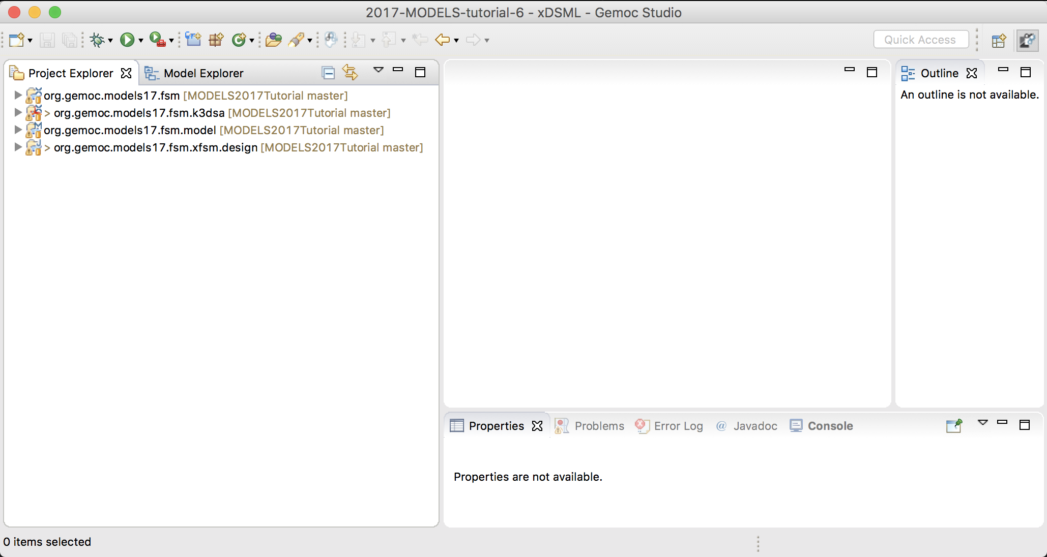
2.1. Overview the language example provided for the tutorial
Clone the Github repo of the tutorial
Start the GEMOC Studio on a fresh workspace
Import in your workspace the projects from /code/languagewb/*
- <number>

Slide 38
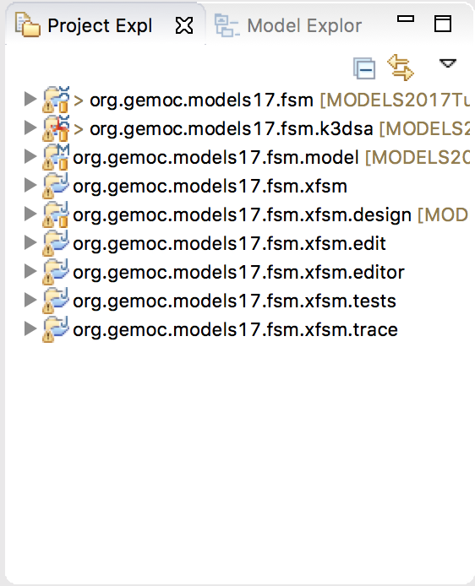
2.1. Overview the language example provided for the tutorial
Install the GEMOC Concurrent Engine
Help -> Install Additional GEMOC Components > GEMOC Concurrent Engine
Generate the domain-specific trace backend
DSL file -> GEMOC Language -> Generate Multidimensional Trace Addon project for langage
Generate the EMF edition layer
Open org.gemoc.models17.fsm.model/model/model.genmodel
Right click on the root -> Generate All
- <number>

Slide 39
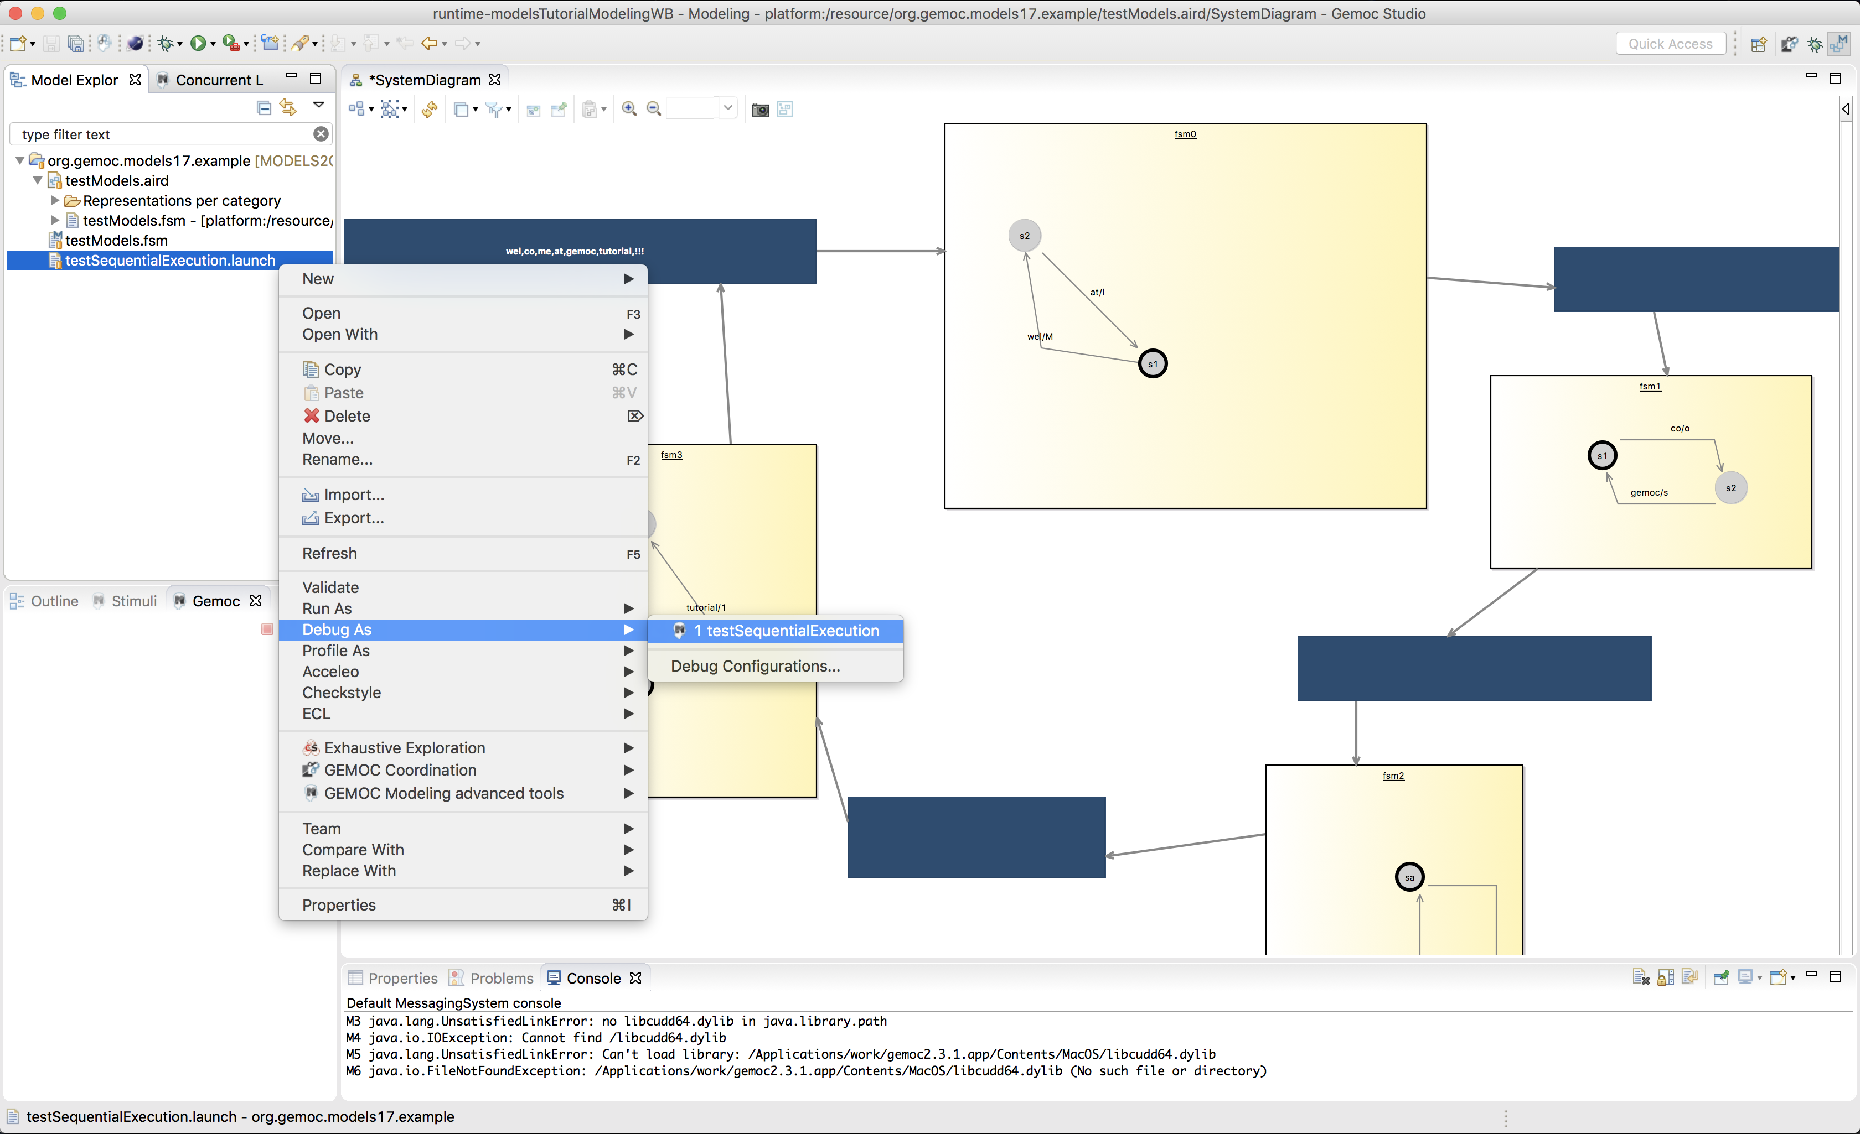
2.2. Playing with the modeling workbench
Launch a new Eclipse instance (use the launch config ‘modeling workbench’)
Import the model example (project code/modelingwb/ org.gemoc.models17.example)
Open the testModels.aird, and then the diagram (systemDiagram)
Start the launch configuration in debug mode
- <number>

Slide 40
2.3. Complementing the execution semantics
Implement the methods:
“step” on State which select a fireable transition according to the current state
“fire” on Transition which makes the action to evolve the dynamic information related to the firing of the transition
- <number>

Slide 41
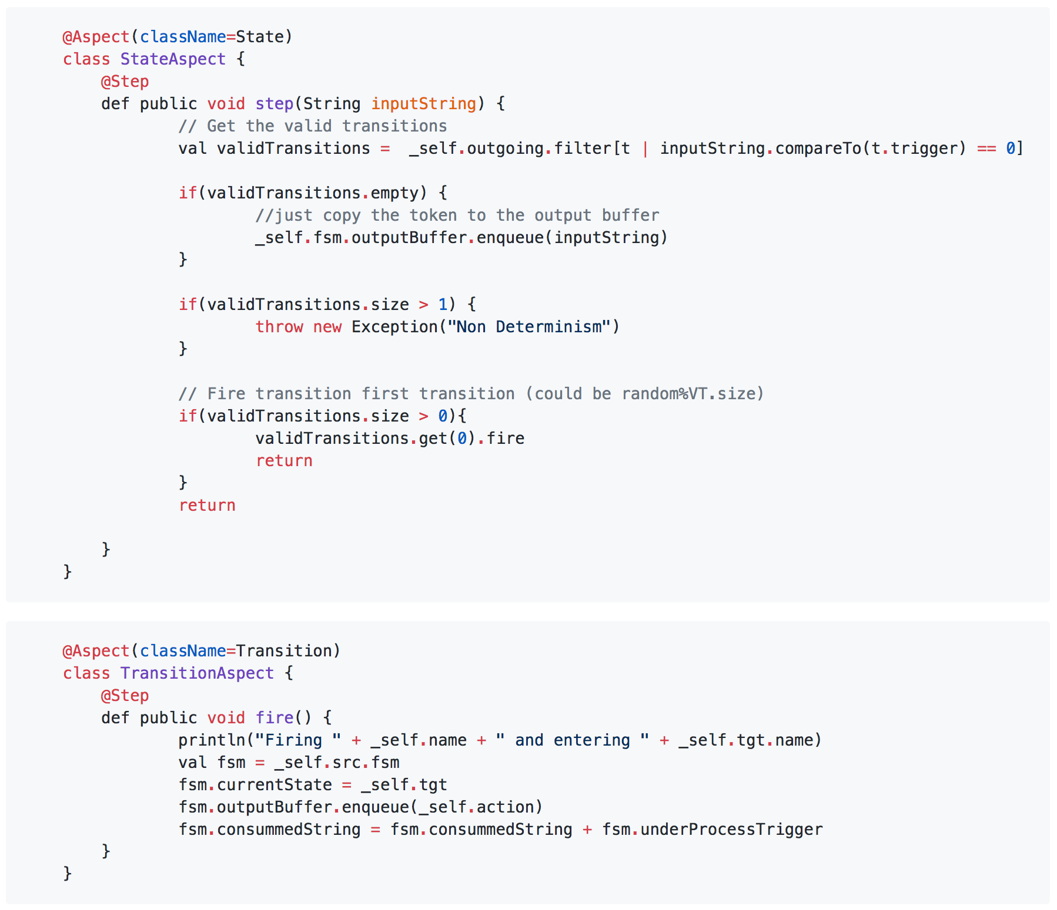
2.3. Complementing the execution semantics
- <number>

Slide 42
2.4. Deploying the modeling workbench and playing with the example model
Do 2.1 > step 4 (each time you modify the semantics)
Do 2.2
See the diff ☺
- <number>

Slide 43
Weave Concurrency Constraints Into Your DSL!
- <number>

Slide 44
Julien ;)
(see https://github.com/gemoc/MODELS2017Tutorial)
- <number>

Slide 45
Conclusion
- <number>

Slide 46
Conclusion
Scientific breakthroughs:
A concurrent and modular executable metamodeling approach
Cross-fertilization of the algorithm theory and the concurrency theory
An explicit behavioral language interface
The reification of the coordination concerns at the language level
Technological breakthroughs:
Dedicated meta-languages integrated into the GEMOC Studio, atop Eclipse Modeling
Execution environment integrated within the Eclipse debug UI, incl. graphical animation, omniscient debugging, concurrency analysis and behavioral coordination
Wrap-up and Discussions – GEMOC Workshop (Mar., 2016)
- <number>

Slide 47
Conclusion
Software components:
Sirius Animator: execution engine, animator designer/runtime, omniscient debugger, and trace/event managers
Host on Sirius lab for maturation as an Eclipse plugin (Obeo/INRIA)
https://github.com/SiriusLab/ModelDebugging
MoccML
will be diffused as an open source project (I3S/ENSTA Bretagne)
https://github.com/gemoc/concurrency
BCOoL and heterogeneous engine coordination
will be diffused as an open source project (I3S/INRIA)
https://github.com/gemoc/coordination
GEMOC studio: language and modeling workbench, wizard/dashboard, documentation and examples
https://github.com/gemoc/gemoc-studio
Wrap-up and Discussions – GEMOC Workshop (Mar., 2016)
- <number>

Slide 48
Ongoing Developments
Deep investigation of the notion of language interface (viewpoint engineering, etc.)
Domain-specific property language, incl. for breakpoint definition
Simulation, model explorer, model checking
Coordination of discrete and continuous models
Co-simulation (incl., FMI)
Live and collaborative modeling (e.g., for sustainability systems)
Wrap-up and Discussions – GEMOC Workshop (Mar., 2016)
- <number>

Slide 49
Perspectives
Formal analysis of model coordination
Adaptable MoC at the language level
@design/compile time: design space exploration, optimizing compilers
@runtime: code adaptation, code obfuscation
SLE in Education
Wrap-up and Discussions – GEMOC Workshop (Mar., 2016)
- <number>

Slide 50

Hack your own languages?
Join us in the MDE/SLE group of the CNRS IRIT lab, in a freshly rebuilt campus of the warm city of Toulouse!
Open Positions
for PhD and Postdoc
Benoit Combemale
Professor, Univ. Toulouse, France
http://combemale.Fr
benoit.combemale@irit.fr
@bcombemale

Slide 51


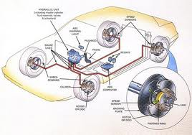
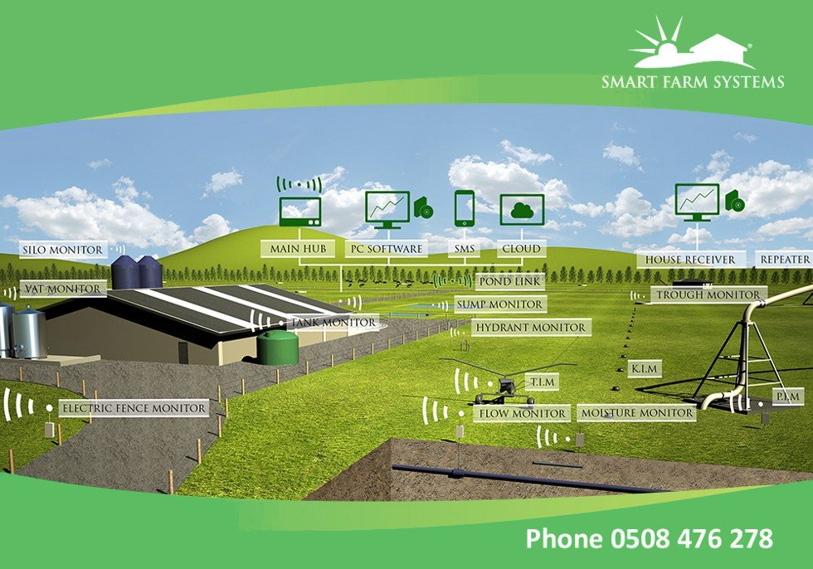
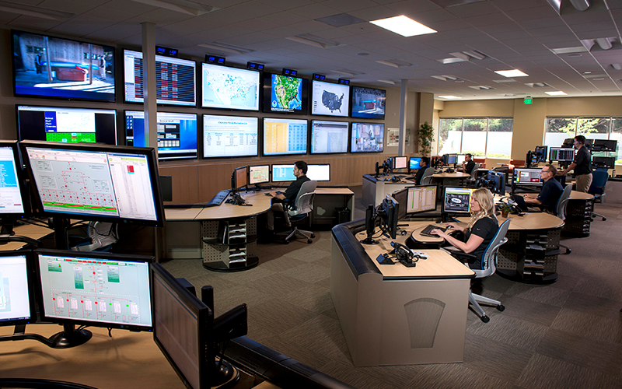
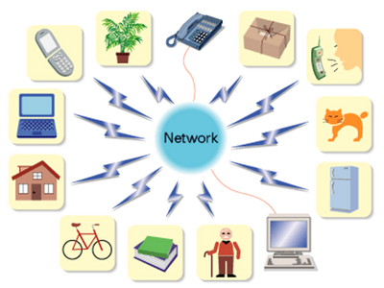
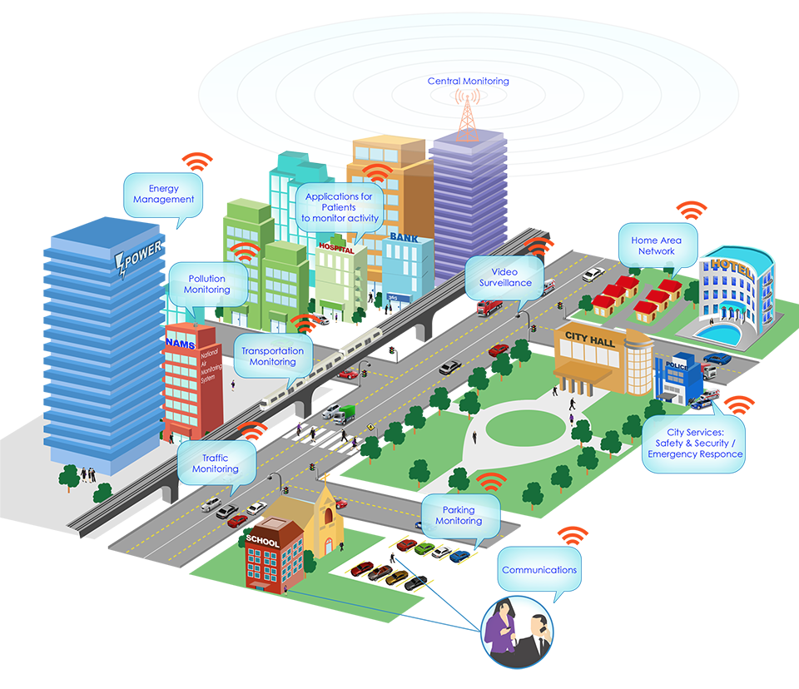

Complex Software-Intensive Systems
Multi-engineering approach
Domain-specific modeling
High variability and customization
Software as integration layer
Openness and dynamicity
GEMOC Studio Tutorial @ MODELS 2017 – Benoit Combemale and Julien Deantoni – Sep., 2017
- <number>
Notes:
<number>

Slide 52


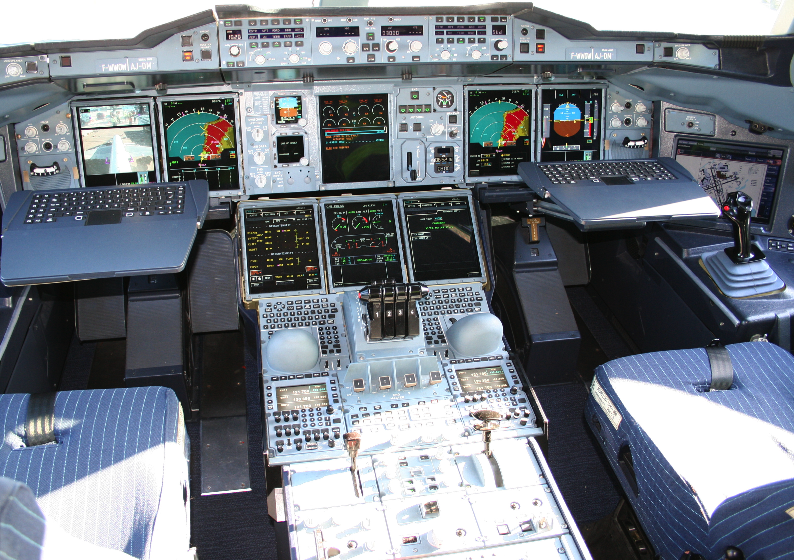









Mechanical
Structure
Airlines
Human-Machine Interaction
Avionics
Multiple
Concerns
Aerodynamics
Environmental
Impact
Propulsion
System
Safety
Regulations
Communications
Authorities
Navigation
<number>
Notes:
This piece of complex software integrates different perspectives from these stakeholders
Physics, communications, Pilots -> HCI
<number>

Slide 53
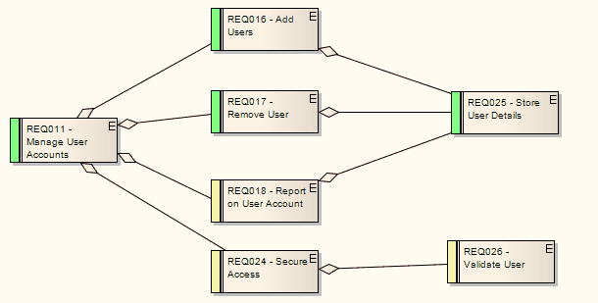
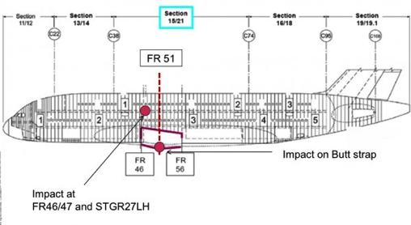
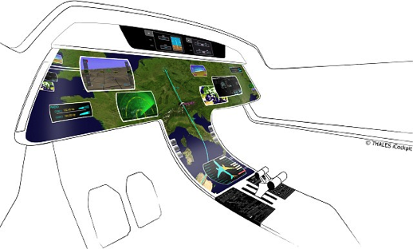
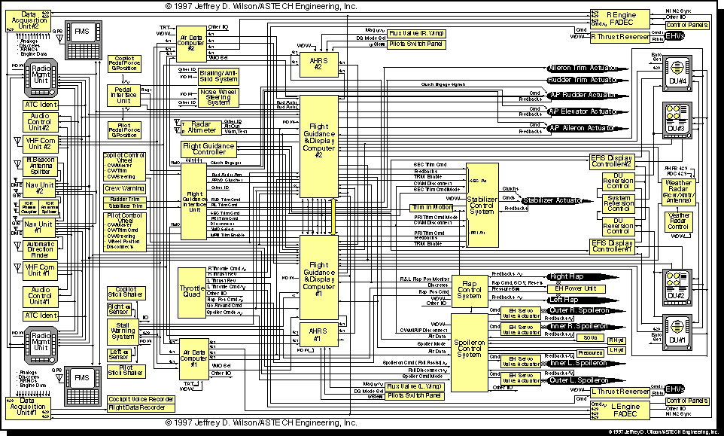
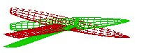
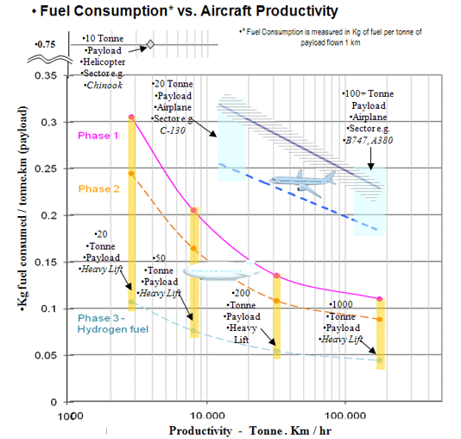
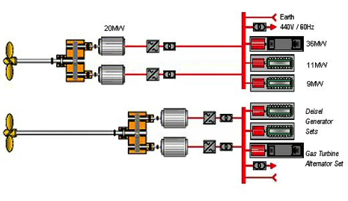
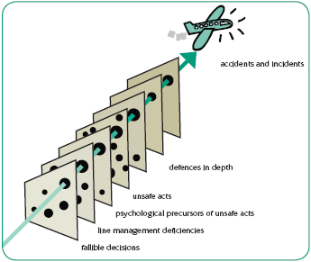
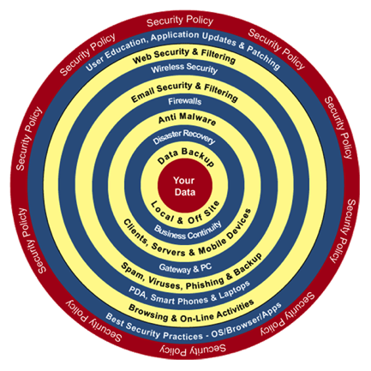
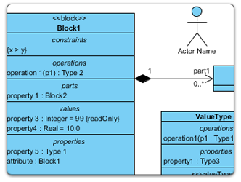
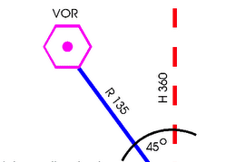
Mechanical
Structure
Airlines
Human-Machine Interaction
Avionics
Heterogeneous Modeling
Aerodynamics
Environmental
Impact
Propulsion
System
Safety
Regulations
Communications
Authorities
Navigation
<number>
Notes:
Parler ici du positionnement avec la co-simulation
<number>

Slide 54
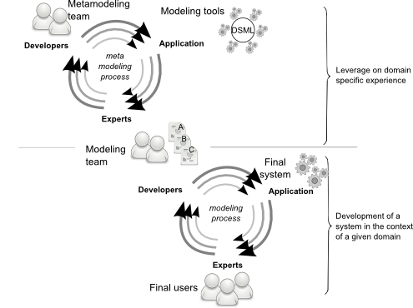
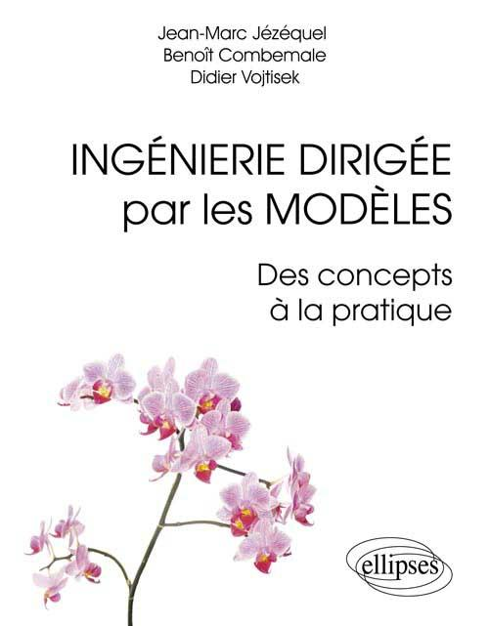
Language-Oriented Programming & Modeling
Ingénierie Dirigée par les Modèles : des concepts à la pratique, by Jézéquel, J.-M., Combemale, B., Vojtisek, D., Références sciences, ellipses (Eds.). 2012.
Engineering Modeling Languages: Turning Domain Knowledge into Tools, by Benoit Combemale, Robert B. France, Jean-Marc Jézéquel, Bernhard Rumpe, Jim R.H. Steel, and Didier Vojtisek. Chapman and Hall/CRC, pp.398, 2016. Companion website: http://mdebook.irisa.fr
GEMOC Studio Tutorial @ MODELS 2017 – Benoit Combemale and Julien Deantoni – Sep., 2017
- <number>

Slide 55
Language Design and Implementation
Ingénierie Dirigée par les Modèles : des concepts à la pratique by Jézéquel, J.-M., Combemale, B., Vojtisek, D., Références sciences, ellipses (Eds.). 2012.
Engineering Modeling Languages: Turning Domain Knowledge into Tools, by Benoit Combemale, Robert B. France, Jean-Marc Jézéquel, Bernhard Rumpe, Jim R.H. Steel, and Didier Vojtisek. Chapman and Hall/CRC, pp.398, 2016. Companion website: http://mdebook.irisa.fr
GEMOC Studio Tutorial @ MODELS 2017 – Benoit Combemale and Julien Deantoni – Sep., 2017
- <number>

